Slide 1


Factors that Contribute to Student Success on Exams
By Christina Vosnak
Notes:
Hello and welcome to this presentation which will analyze factors that contribute to student success specifically on exams.

Slide 2

Business Problem
Student success is of the utmost importance in any educational institution
Goal: to identify factors that most significantly contribute to exam scores
Notes:
As we may know, student success is of the utmost importance in any educational institution, so the goal of this project is to identify factors that most significantly contribute to exam scores to provide insights to help educators impliment targeted change to enhance student learning outcomes

Slide 3
Key Stakeholders
School Administrators
Parents
Students
Notes:
I’ve identified 3 key stakeholders who will benefit from this information: school administrations who will seek these insights to meet performance benchmarks, parents who want to know how they can help support their childs academic growth, and students themselves who are interested in recognizing habits, environments and support systems that can help them achieve their full academic potential

Slide 4

Data Collection
Student Performance Factors Dataset
6000+ Student Records
Categorical and Numerical Variables
Notes:
For this project, I collected data from Kaggle by using a dataset entitled Student Performance Factors which includes over 6000 student records across 20 categorical and numerical variables.

Slide 5
Exploratory Data Analysis
Remove missing values
Understand Outliers
One-hot encode categorical variables
Notes:
I then conducted an exploratory data analysis in which I removed 3 columns filled with missing categorical data and rather than making inferences that may skew modeling results, completely removed the columns from the dataset. I then created boxplots to identify outliers and distribution charts to understand outliers in the dataset where I found 3 columns with “outliers’ identified however, after further analysis realized that the data just had a skewness in distribution. Because of this, I decided to leave the outliers as is in the dataset as they may contribute to modeling results. Finally, I created dummy variables through one-hot encoding to transform categorical features into numerical features that can be used for modeling purposes.

Slide 6
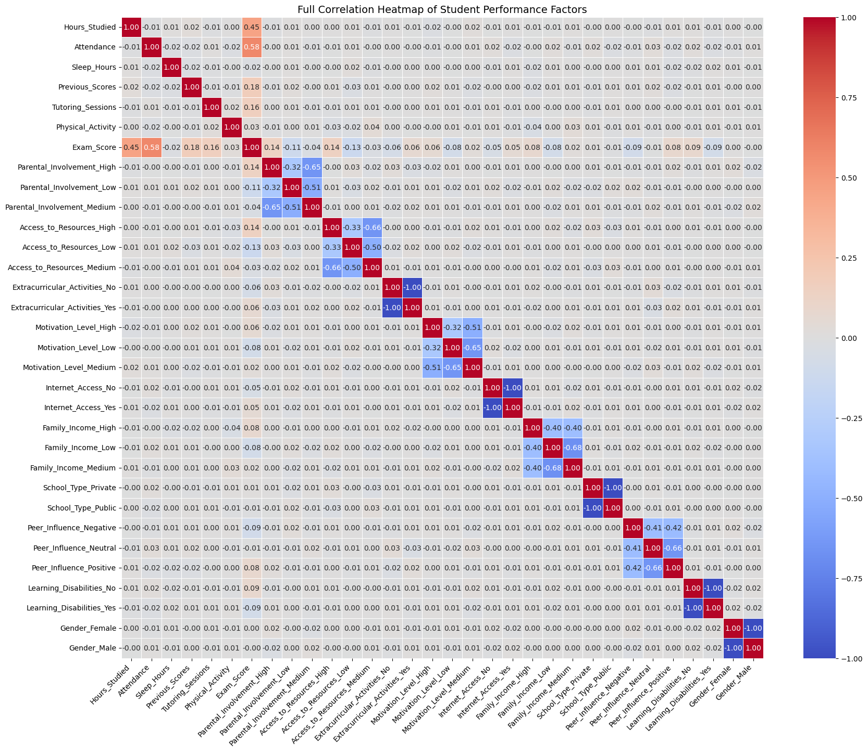
Correlation Matrix
Notes:
I then created a correlation matrix of all features to identify preliminary relationships within the data. I found that hours studied and attendance most correlated to exam score.

Slide 7
Models
Linear Regression
To identify linear relationships
Random Forest Classifier
To identify non-linear relationships
Gradient Boosting
To identify more complex non-linear relationships that Random Forest may miss
Notes:
I then selected 3 models to test with the data which are linear regression to identify linear relationships within the data, random forest classifier to identify non-linear relationships as well as gradient boosting to identify more complex non-linear relationships that random forest may miss

Slide 8
Evaluation Metrics
MAE – Mean Absolute Error
Clear interpretable measure using average error
R^2 Score
Explains variations in the target variable
RMSE – Root Mean Squared Error
Balanced evaluation metric that is more sensitive to outliers
Notes:
I’ve also selected 3 evaluation metrics to evaluate each model. I will use MAE R^2 score RMSE Root Mean Squared Error

Slide 9

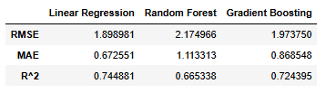
Results
Linear Regression Performed Best
Lowest RMSE
Lowest MAE
Highest R^2 Score

Slide 10
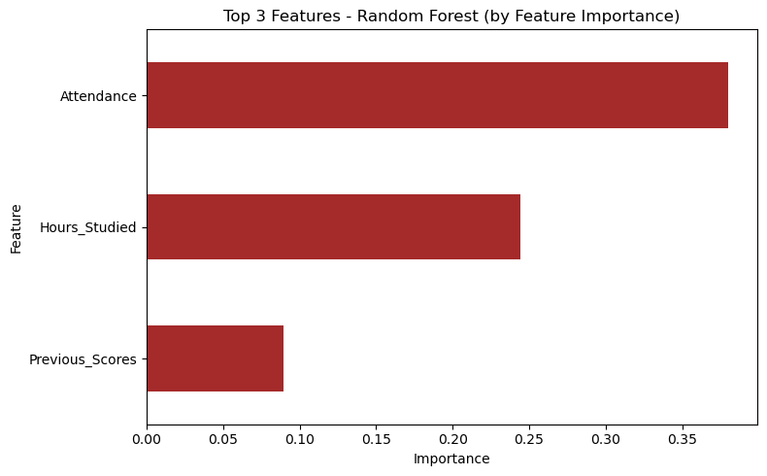
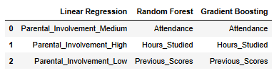
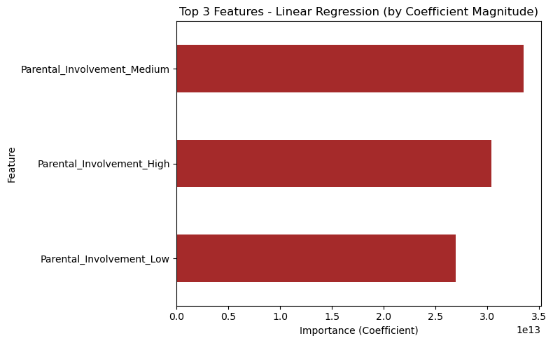
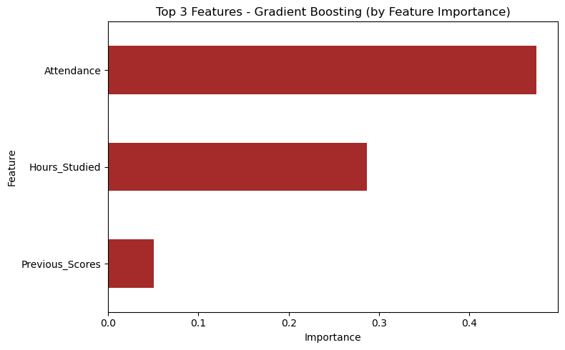
Top 3 Features

Slide 11
Conclusions
Stress importance of parental involvement
1
Reward great attendance habits
2
Implement an after school study program
3

Slide 12
Further Research
Use Real World Data
Increase Sample Size
Adjust based on educational institution

